Slide 1

How can Information Literacy be modelled
from a lifelong learning perspective?
C. Irving, H. Hall, & A. Brettle
Presented by:
Christine Irving
Research Fellow & PhD Student
Centre for Social Informatics,
Edinburgh Napier University
c.irving@napier.ac.uk
@CM_Irving
Paper presented at Information: interactions and impact (i3)
Aberdeen, June 2015
Slide 1 of 24
Notes:
Paper derives in part from a number of studies that have previously been published by myself. These studies are currently being reappraised as part of the process of critical evaluation in preparation for the submission of a thesis for PhD by Published Works.
The body of work that considers information literacy in the context of lifelong learning. This can be traced back to 2004 and the Scottish Information Literacy Project. A major outcome of the project was the development of an information literacy framework for secondary and higher education in Scotland (Irving & Crawford, 2006; Irving, 2007) that included in its provision preparation for the world of work (Crawford & Irving, 2007). Over the years the lifelong learning focus was expanded and strengthened to include the broader themes of: information literacy in the workplace (Crawford & Irving, 2009); adult literacy and public library activities – including: employability (Crawford & Irving, 2012) and health (Irving, 2013a); also taking into account information literacy as an early-years issue (Irving, 2013b).

Slide 2
Presentation overview
  Literature review highlights
  Examples of models and frameworks
    Sector specific
    Life wide
  What needs to appear in a more comprehensive model?
  Draw on the work of the Scottish Information Literacy project / National Information Literacy framework (Scotland)
  Prototype model
Slide 2 of 24

Slide 3
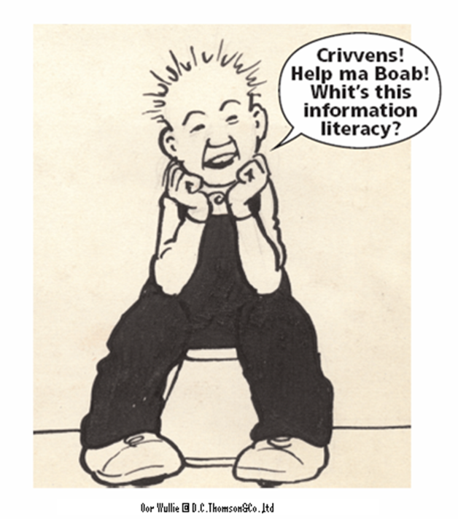
Information Literacy definition/s
  number of definitions; some commonality but they can vary by: country, institutions, LIS professional bodies, non government organisations, researchers and practitioners
  some recognition for the term gained predominantly within LIS but explanation still required
CILIP (2004) Definition
Information Literacy is knowing when and why you need information, where to find it, and how to evaluate, use and communicate it in an ethical manner.
Slide 3 of 24
Notes:
“need to define the term in a way that [wa]s understandable by all information-using communities in the UK” (CILIP, 2004 cited by Irving, 2012, p.50).

Slide 4
Information Literacy 1974-2004
1970s
Term coined by Paul Zurkowski (1974) US Information Industries Association
Information Literacy initiatives in Australia originated in the school library sector
1980s
Information Literacy initiatives in New Zealand in the school library sector mid-1980s
ALA (1989) highlights the importance of Information Literacy to individuals, business, and citizenship
1990s
Higher education librarians became Information Literacy’s main advocates
UK HE model - SCONUL Seven pillars of information skills model
2000s
Webber & Johnston define information literacy as an efficient and ethical information behaviour
Prague Declaration (UNESCO, identifies Information Literacy as part of the basic human right of life long learning
CILIP (2004) recognises the need to define Information Literacy in a way that was understandable by all information-using communities in the UK
Slide 4 of 24

Slide 5
Information Literacy narrative
Three different but overlapping strands:
  texts written by practitioners examples of good practice
  policy-making texts that explicitly stress the importance of all people becoming information literate, e.g. documents published or supported by organizations such IFLA and UNESCO
  contains a growing body of empirically and theoretically grounded research texts produced at university departments
  Pilerot and Lindberg (2011) & Pilerot (2014)
Slide 5 of 24
Notes:
The work will also make reference to a number of recent high-profile, and often idealistic, declarations on the importance of, and necessity for, an information literate population (e.g. Garner, 2006; IFLA, 2014). It will show how these have been handled by information literacy practitioners as tools for advocacy, despite the general problems associated with such documents, as identified by the research community (for example: Pilerot, 2015; Pilerot & Lindberg, 2011).

Slide 6
Information Literacy research focus -> 2004
  Lloyd (2005)
  Foreman & Thomson (2009)
Higher education
Workplace
Jackson (2010)
Goldstein (2014)
2004 ->
Bruce (1998)
SCONUL (1999)
Johnston & Webber (2003)
Wai-yi Cheuk (1998, 2002)
Bruce (1999)
Lloyd (2004)
2004 ->
Herring (1996, 1999, 2004)
Williams, Wavell & Coles (2001)
Pickard (2004)
Shenton (2004)
Brettle (2003)
2004 ->
(Pre-) school
Health
Irving (2006)
Wilson (2015)
Slide 6 of 24
Notes:
Formal education was traditionally the main focus: for example in 2004:
Higher education provision for students (for example, Bruce, Edwards & Lupton, 2006; Johnston & Webber, 2003)
School sector most notably the skills of school pupils and in some cases that of teachers and the role of schools librarians in developing information skills (Herring, 1998; Williams, Wavell & Coles, 2001: Shenton & Dixon, 2004).
Young people’s information seeking skills in conjunction with the Internet – real and perceived (Herring, 2004; Pickard, 2004; Shenton, 2004).
However … there were some researchers working in other areas for example the workplace:
Cheuk (1998, 2002) Information literacy model in the workplace: case studies and workplace context.
Bruce (1999) Workplace experiences of information literacy
Lloyd (2004) ‘Working (In) formation: Conceptualizing information literacy in the workplace’, in Life Long Learning: Whose Responsibility and What is your Contribution?

Slide 7
Information Literacy research focus
Higher education
  Lloyd (2005)
  Foreman & Thomson (2009)
  Reedy, Mallett, & Soma (2013).
Jackson (2010)
  Webber & Johnston (2013)
Goldstein (2014)
Workplace
2004 ->
Graduateness
Employability
Bruce (1998)
SCONUL (1999)
Johnston & Webber (2003)
Cheuk (1998, 2002)
Bruce (1999)
Lloyd (2004)
Workplace learning / Trade union education and learning
2004 ->
-> 2004
-> 2004
  Williams, Cooper & Wavell (2014)
  Wilson (2015
Wilson (2015)
Herring (1996, 1999, 2004)
Williams, Wavell & Coles (2001)
Pickard (2004)
Shenton (2004)
Health
Brettle (2003)
Brettle (2003)
Arthur, Stewart, & Irving (2005)
Irving (2013)
-> 2004
-> 2004
2004 ->
Early years
2004 ->
Health
Civil rights: engagement in democracy / politics
refugees
Homelessness
(Pre-) school
  Muggleton & Ruthven (2012)
  Lloyd, Kennan, Thompson & Qayyum (2013)
  Smith (2014)
Life
Policy formation
Slide 7 of 24
Notes:
The workplace. For example:
Lloyd (2005) - research into workplace practice (most notably re ambulance drivers, firefighters) Theoretical work includes situated at the intersection of the themes of information, learning and work practice.
Foreman, J. & Thomson, L. (2009) The development of an information literacy strategy for the Scottish Government. Paper presented at the Librarians’ Information Literacy Annual Conference, 29th – 31st March 2010. Limerick, Republic of Ireland. Available at: http://www.lilacconference.com/dw/programme/Presentations/Tuesday/Strand_City_View_Suite/Foreman_HigginsonLILAC_conference_Final.pdf
Higgison & Foreman (2013) Scottish Government information literacy in the workplace – measuring impact
For a fuller list see Williams, Cooper & Wavell (2014) Information Literacy in the Workplace: An annotated bibliography
Graduate-ness & Employability. For example:
Jackson , A. (2010) Just enough education to perform : information skills, professionalism and employability. Paper presented at the Librarians’ Information Literacy Annual Conference, 29th – 31st March 2010. Limerick, Republic of Ireland. Available at: http://www.lilacconference.com/dw/programme/Presentations/Wednesday/Lecture_Theatre/Jackson_just_enough_education.pdf
Goldstein, S., (2014) Transferring information know-how: Information literacy at the interface between higher education and employment. InformAll – http://www.researchinfonet.org/wp-content/uploads/2014/09/Report-on-transferability-of-IL-beyond-academia-FINAL.pdf
Webber & Johnston - Information Literate Lives in the 21st Century (2013); Transforming IL for HE in the 21st century: a Lifelong Learning approach (2013).
Trade Union Education and Learning. For example:
Irving, C. (2006). The role of information literacy in addressing a specific strand of lifelong learning: the work agenda. Available at: http://static1.1.sqspcdn.com/static/f/1070488/16374280/1328186902467/InformationLiteracyintheworkplacearticle.pdf?token=KE38D2zWKw5jHEceqMBZp%2BDoQN8%3D included interviewing Development Officer Everyday Skills – Scottish Trade Union Congress – led onto further discussions with Trade Union Learning Officers
Wilson , T. (2015) Information Literacy and Trade Unions . Paper presented at the Librarians’ Information Literacy Annual Conference, 8th – 10th April 2015. Newcastle, UK. Available at: Information Literacy and Trade Unions (audio only).
Civil right: engagement in democracy / politics; refugees; homelessness. For example:
Smith, L. (2014) Critical Information Literacy for the Development of Political Agency. Paper presented at the IFLA WLIC 2014 Information Literacy Satellite, 16-22 August 2014, Lyon, France Available at: https://laurensmith.files.wordpress.com/2014/08/critical-information-literacy-for-the-development-of-political-agency-ifla-satellite-limerick-2014.pdf
Smith’s new research - Learning, lending, liberty? Can school libraries be engines for youth citizenship? Will look at young people’s information and information literacy (IL) needs outside of the school environment and identify how IL skills are vital in helping them become informed and meaningful participants in politics.
Lloyd, A., Kennan, M. A., Thompson, K. M., & Qayyum, A. (2013). Connecting with new information landscapes: Information literacy practices of refugees. Journal of Documentation, 69(1), 121-144.
Muggleton, T. H., & Ruthven, I. (2012). Homelessness and access to the informational mainstream. Journal of Documentation,68(2), 218-237.
Growing interest in policy formation example:
Horton, Weiner, Whitworth, Pilerot & Lindberg, Haras & Brasley, Jacobs & Berg, Basili, Irving in Crawford, J. (Ed) (2011). Information literacy beyond the Academy, Part 1: Towards policy formation, Library Trends, 60(2).

Slide 8
Information Literacy and lifelong learning
ALA 's Presidential Committee on Information Literacy was appointed in 1987
  Information Literacy: the key competency for the 21st century (Bundy, 1998)
  SCONUL Task Force (December 1998)
  Prague Declaration Towards an information literate society (UNESCO 2003)
  Alexandria Proclamation on Information Literacy and lifelong learning , in 2005 (Garner, 2006)
Slide 8 of 24
Notes:
American Library Association (ALA) 's Presidential Committee on Information Literacy was appointed in 1987 with three expressed purposes:
to define information literacy within the higher literacies and its importance to student performance, lifelong learning, and active citizenship;
to design one or more models for information literacy development appropriate to formal and informal learning environments throughout people's lifetimes; and
to determine implications for the continuing education and development of teachers.
Alexandria Proclamation on Information Literacy and Lifelong Learning (2005)
proclaims that information literacy and lifelong learning are the beacons of the Information Society
Information Literacy lies at the core of lifelong learning;
urges governments and intergovernmental organizations to pursue policies and programs to promote [and invest in] information literacy and lifelong learning
2009 – President Obama’s proclamation declaring October as National Information Literacy Awareness Month
CILIP endorses the Alexandria Proclamation on Information Literacy in 2011

Slide 9
Lifelong learning definition examples
In contemporary conditions learning becomes not only ‘lifelong’, suggesting learning as relevant throughout the life course, but also ‘life wide’, suggesting learning as an essential aspect of our whole life experience, not just that which we think of as ‘education’. Harrison, Reeve, Hanson,. & Clarke. (2002, p.1)
  [lifelong learning is about] … “personal fulfilment and enterprise; employability and adaptability; active citizenship and social inclusion”...
  “encompassing formal and informal learning, workplace learning, and the skills, knowledge, attitudes and behaviours that people acquire in day-to-day experience”. Scottish Executive’s (2003, p.7)
Slide 9 of 24
Notes:
Learning as a preparation for life has been displaced by learning as an essential strategy for successful negotiation of the life course, as
conditions in which we live and work are subject to ever more rapid change.

Slide 10
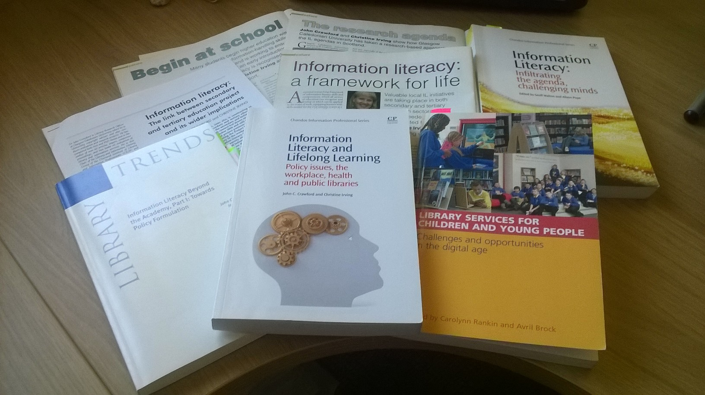
  Irving (2006, 2010, 2011, 2013) Irving & Crawford (2007)
  Crawford & Irving (2007, 2009, 2012, 2013)
Information Literacy in the context of lifelong learning
Slide 10 of 24
Notes:
Body of work: 2004 - Information literacy across lifelong learning including policy and advocacy work:
linking information literacy skills and competencies in secondary education to those in tertiary education as preparation for the world of work (Crawford & Irving, 2007).
information literacy in the workplace (Irving, 2006; Crawford & Irving, 2009);
IL and the petition to the Scottish Parliament (Crawford & Irving, 2007)
The Curriculum for Excellence: knowledge, engagement and contribution by Scottish School librarians (Irving, 2010)
information literacy in the workplace and the employability agenda Crawford & Irving (2011)
adult literacy and public library activities with specific reference to employability training (Crawford & Irving, 2012);
information literacy as an early years issue (Irving, 2013).
Information literacy in health management: supporting the public in their quest for health information (Irving, 2013)
Information literacy and lifelong learning: policy issues, the workplace, health and public libraries (Crawford & Irving, 2013)

Slide 11
The distinction between a model & a framework
Frameworks - the way ideas are organised; classification
Model
  smaller entity than a framework (a framework may include models)
  shows relationships between entities
  shows how concepts are operationalised
Slide 11 of 24

Slide 12
Information Literacy models & frameworks – examples
  SCONUL 7 Pillars of Information Literacy (1999); Bent & Stubbings (2011)
  PLUS Information Skills Model (Herring, 1996, 1999)
  NHS Education for Scotland Information Literacy Framework (2008)
Individually they are:
  valuable in their own right but …
  not easily applied to other contexts and
  do not aid transition from one sector to another and lifelong learning however …
Slide 12 of 24

Slide 13
National Information Literacy Framework (Scotland) Irving (2007)
Slide 13 of 24
Notes:
The value of this framework is that it goes across sectors
http://www.educationscotland.gov.uk/Images/information_literacy_framework_draft_tcm4-433724.pdf
The National Information Literacy Framework (Scotland), was developed between 2005 & 2010 by the presenter of this i3 paper. The framework is one of a number of outputs from the Scottish Information Literacy Project that have informed a range of initiatives that includes: http://www.therightinformation.org/framework-home/ http://www.caledonianblogs.net/information-literacy/
The model was developed with reference to a number of extant models of information literacy to highlight the skills commonality between the different sectors.
The approach taken in the development of the framework over the five-year period between 2005 and 2010 was, however, a pragmatic one and very much practitioner-focused. It demonstrated how “information literacy can be viewed as the practitioners’ model for delivering information capability” (Hepworth & Walton, 2013). Therefore, as well as describing the development of the new model from the initial framework, a key focus of this i3 paper is to situate the framework within an academic context with reference to well-established theoretical perspectives on information behaviours and use. The new model thus integrates extant knowledge and theoretical perspectives with new insight

Slide 14
National Information Literacy Framework (Scotland) Irving (2007)
However what is missing is …
iterative process
multifaceted aspect of individuals and information resources
information context
information behaviour
Slide 14 of 24
Notes:
Whilst the value of this framework is that it goes across sectors it is missing ….

Slide 15
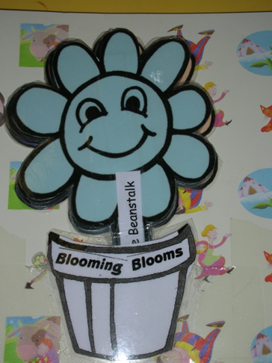
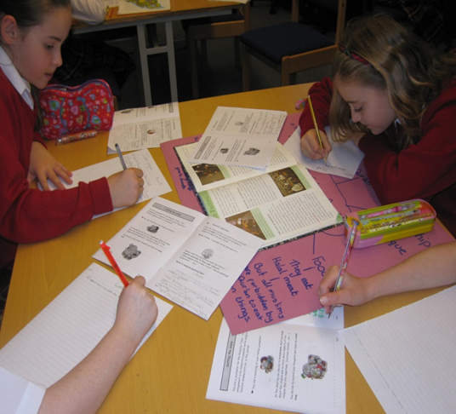
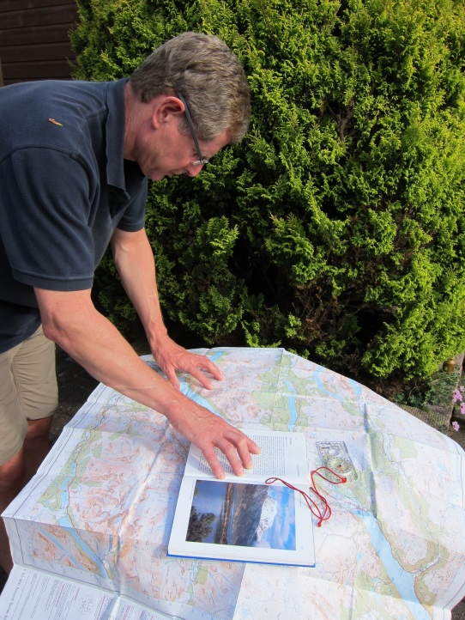
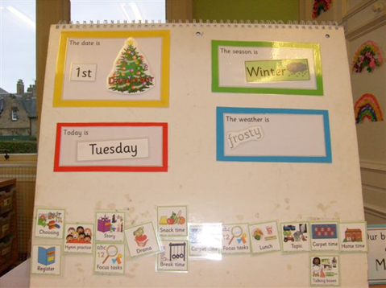
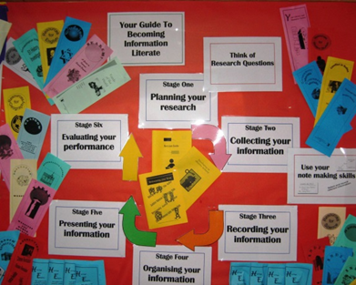
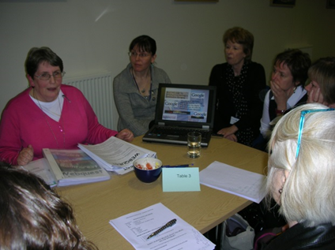
Information Literacy through different lenses
Slide 15 of 24
15
Notes:
The presentation will explore how concepts of information literacy differ at various points, and highlight strategies for addressing these differences in the delivery of information literacy support. It will take into account the multifaceted nature of information literacy and demonstrate how information literacy takes on new meaning at different stages of lifelong learning, not least because information comes in many different forms. It will examine the need for different types of provision for specific groups, and reveal how information literacy and the patterns of information behaviour in different contexts vary depending on experience and the context of the prevailing information environment in question.

Slide 16
More comprehensive lifelong learning model required
  What is needed is a model:
    To aid transition across the lifelong learning sectors
    To recognise different information literacies, Information Literacy landscapes (education, workplace, life) e.g. Information Literacy as a socially enacted practice (Lloyd, 2010)
    To incorporate knowledge and experiences – we don’t all have the same
    To take into account information behaviour – theories and practice
Slide 16 of 24
Notes:
Hepworth, M. & Walton, G. (2013). Introduction – information literacy and information behaviour, complementary approaches for building capability. In M. Hepworth & G. Walton (Eds.) Developing people’s information capabilities: fostering information literacy in educational, workplace and community contexts. Bingley: Emerald.
Webber & Johnston define information literacy as an efficient and ethical information behaviour

Slide 17
Elements to be included in the Irving model
Information Literacy Landscapes
Education
Literacies
Literacy
Information Resources
people, print and digital media plus “other forms of media – film, video, DVD, radio television, etc.” (Armstrong et. al., 2005, p.23)
Information Behaviour
Work
Information Literacy
Digital Literacy
Life:
Social
Citizenship
Relationship with Information Literacy
Slide 17 of 24
Notes:
Brings together:
Skills and capabilities concept – from traditional focus
Incorporates:
Different lenses - representing the different groups of people/learners from i.e. SCONUL Seven Pillars of Information Literacy 2011 revised model (Bent & Stubbings, 2011)
Presents:
the ‘multifaceted nature’ of information literacy
an holistic view

Slide 18
Prototype model: work in progress
Aid transition
Education
Workplace
Information resources
Knowledge & experience
Lifelong learning
Aid transition
Aid transition
Literacies: skills & capabilities
Information behaviour
Life
Policy formation
Slide 18 of 24

Slide 19
References
American Library Association (1998) A Progress Report on Information Literacy: An Update on the American Library Association Presidential Committee on Information Literacy: Final Report. American Library Association, Chicago. Retrieved June 19, 2015 from http://www.ala.org/acrl/publications/whitepapers/progressreport
Arthur, R., Stewart, C. and Irving, C. (2005). Bite-sized learning for all Scottish citizens, Library + information update, 4 (1-2), 22-25.
Armstrong, C., Abell, A., Boden, D., Town, S., Webber, S. and Wooley, M. (2005). Defining information literacy for the UK, Library + information update, 4 (1-2) 22-25.
Bent, M. & Stubbings, R. (2011). The seven pillars of information literacy: the core model for higher education. Retrieved January 9, 2015 from http://www.sconul.ac.uk/sites/default/files/documents/coremodel.pdf
Brettle, A. (2003). Information Skills Training: A Systematic Review of the Literature.” Health Information and Libraries Journal 20. Suppl1: 3-9.
Bruce, C.S. (1998). The phenomenon of Information Literacy, Higher Education Research & Development, 17(1), 25-43.
Bruce, C.S. (1999). Experiences of Information literacy in the Workplace, International Journal of Information Management, 19(1), 33-48.
Bundy, A. (ed.). (2004). Australian and New Zealand Information Literacy Framework: principles, standards and practice(2nd ed.). Adelaide: Australian and New Zealand Institute for Information Literacy.
CILIP (2004). (2004). Information literacy – definition. Retrieved June 19, 2015 from http://www.cilip.org.uk/cilip/advocacy-campaigns-awards/advocacy-campaigns/information-literacy/information-literacy
Cheuk, Bonnie. “Information Literacy in the Workplace Context: Issues, Best Practices and Challenges.” July 2002. White Paper prepared for UNESCO, the U.S. National Commission on Libraries and Information Science, and the National Forum on Information Literacy, for use at the Information Literacy Meeting of Experts, Prague, The Czech Republic.
Crawford, J. & Irving, C. (2007). Information literacy, the link between secondary and tertiary education project and its wider implications. Journal of Librarianship and Information Science, 39(1), 17-26.
Slide 19 of 24

Slide 20
References
Crawford, J. & Irving, C. (2009). Information literacy in the workplace: a qualitative exploratory study. Journal of librarianship and information Science, 41(1), 29-38. Crawford, J. & Irving, C. (2012). Information literacy in employability training: the experience of Inverclyde Libraries. Journal of Librarianship and Information Science, 44(2), 79-89.
Crawford, J.C. & Irving, C. (2013). Information literacy and lifelong learning: policy issues, the workplace, health and public libraries (59-86). Oxford: Chandos.
  Foreman J. & Thomson L. (2009). Government information literacy in the “century of information”. Journal of Information Literacy, 3(2), 64-72.
Garner, S.D. (2006). Report of a high-level colloquium on information literacy and lifelong learning held at the Bibliotheca Alexandrina, Alexandria, Egypt, November 6-9, 2005. Retrieved January 8, 2015 from http://unesdoc.unesco.org/images/0014/001448/144820e.pdf
Goldstein, S., (2014). Transferring information know-how: Information literacy at the interface between higher education and employment. Retrieved June 19, 2015 from http://www.researchinfonet.org/wp-content/uploads/2014/09/Report-on-transferability-of-IL-beyond-academia-FINAL.pdf
Harrison, Reeve, F., Hanson, A. & J. Clarke. (2002). Introduction: perspectives on learning. In Harrison, Reeve, F., Hanson, A. & J. Clarke. (Ed.), Supporting lifelong learning: Vol. 1 perspectives on learning. London: The Stationery Office.
Hepworth, M. & Walton, G. (2013). Introduction – information literacy and information behaviour, complementary approaches for building capability. In M. Hepworth & G. Walton (Eds.) Developing people’s information capabilities: fostering information literacy in educational, workplace and community contexts. Bingley: Emerald.
Herring, J.E. (1996). Teaching information skills in schools. London: Library Association.
Herring, J.E. (1999). Exploiting the Internet as an information resource in schools. London: Library Association.
Herring, J. (2004) The Internet and Information Skills: a guide for teachers and school librarians. London: Facet.
Irving, C (2006). The role of information literacy in addressing a specific strand of lifelong learning: the work agenda. Retrieved April 15th, 2015 from http://www.therightinformation.org/storage/documents/
Slide 20 of 24

Slide 21
References
Irving, C (2007, March). The development of a national information literacy framework (Scotland). Paper presented at LILAC, Manchester Metropolitan University.
Irving, C. & Crawford, J., (2007) Information literacy: a framework for life, Library + information update, 6 (7-8) pp. 52-53.
Irving, C (2010). Case study. Engaging and influencing policy and the curriculum – the Scottish Information Literacy Project experience. In: C. Rankin and A. Brock (eds), Library services for children and young people: challenges and opportunities in the digital age. London: Facet, pp. 49-62.
Irving, C (2011). National information literacy framework (Scotland): pioneering work to influence policy making or tinkering at the edges? Library Trends, 60 (2) pp. 419-439.
Irving, C. (2013). Recognising information literacy as an early-years issue. In J.C. Crawford, & C. Irving (2013). Information literacy and lifelong learning: policy issues, the workplace, health and public libraries (pp. 59-86). Oxford: Chandos.
  Jackson , A. (2010) Just enough education to perform : information skills, professionalism and employability. Paper presented at the Librarians’ Information Literacy Annual Conference, 29th – 31st March 2010. Limerick, Republic of Ireland. Available at: http://www.lilacconference.com/dw/programme/Presentations/Wednesday/Lecture_Theatre/Jackson_just_enough_education.pdf
Johnston, B. & Webber, S. (2003). Information literacy in higher education: a review and case study. Studies in Higher Education, 28(3) 335-352.
Lloyd, A (2004) ‘Working (In) formation: Conceptualizing information literacy in the workplace’, in Life Long Learning: Whose Responsibility and What is your Contribution? Proceedings of the 3rd International Life Long Learning Conference, June 13-16, Central Queensland University Press, Rockhampton, QLD, pp. 218-224.
Lloyd, A (2005). Information literacy; different contexts, different concepts, different truths?’ Journal of Library and Information Science, 37 (2), pp. 82-88.
Lloyd, A. (2010). Information literacy landscapes: information literacy in education, workplace and everyday contexts. Cambridge, UK: Chandos.
Slide 21 of 24

Slide 22
References
Lloyd, A., Kennan, M. A., Thompson, K. M., & Qayyum, A. (2013). Connecting with new information landscapes: Information literacy practices of refugees. Journal of Documentation, 69(1), 121-144.
Muggleton, T. H., & Ruthven, I. (2012). Homelessness and access to the informational mainstream. Journal of Documentation,68(2), 218-237.
NHS Education for Scotland. (2008). Better informed for better health and better care A framework to support improved information use for staff and patients. Retrieved June 19, 2015 from
Pickard, A. (2004). Young people and the internet. Library + Information Update, 3(1): 32-4
Pilerot, O. & Lindberg, J. (2011). The concept of information literacy in policy-making texts: an imperialistic project? Library Trends. 60(2), 338-360.
Pilerot, O. (2014). Connections between research and practice in the information literacy narrative: a mapping of the literature and some propositions. Journal of Librarianship & Information Science. Retrieved March 26, 2015 from http://lis.sagepub.com/content/early/2014/11/24/0961000614559140.full.pdf+html
Reedy, K., Mallett, K., & Soma, N. (2013). iKnow: Information skills in the 21st century workplace. Library and Information Research, 37(114), 105-122.
Scottish Executive (2003). Life through learning through life: the lifelong learning strategy for Scotland. Retrieved June 19, 2015 from http://www.gov.scot/Publications/2003/02/16308/17750
Shenton, A. (2004). Children’s information needs: why do we know so little? Library + Information Update, 3(1): 30-1
Smith, L. (2014) Critical Information Literacy for the Development of Political Agency. Paper presented at the IFLA WLIC 2014 Information Literacy Satellite, 16-22 August 2014, Lyon, France Available at: https://laurensmith.files.wordpress.com/2014/08/critical-information-literacy-for-the-development-of-political-agency-ifla-satellite-limerick-2014.pdf
Society of College, National and University Libraries (1999). Information skills in higher education. Retrieved January 8, 2015 from http://www.sconul.ac.uk/sites/default/files/documents/Seven_pillars2.pdf
UNESCO. (2003). The Prague declaration “Towards an information literate society” Retrieved January 8, 2015 from http://www.unesco.org/new/fileadmin/MULTIMEDIA/HQ/CI/CI/pdf/PragueDeclaration.pdf
Slide 22 of 24

Slide 23
References
Webber, S. and Johnston, B. (2013) Transforming IL for HE in the 21st century: a Lifelong Learning approach. in Hepworth, M. and Walton, G. (Eds.) Developing people's information capabilities fostering information literacy in educational, workplace and community contexts. Emerald. pp.15-30.
  Williams. D., Wavell. C. & Coles. L. (2001). Research into the Impact of school library services on achievement and learning. Retrieved from https://www.rgu.ac.uk/3AC6AB20-595B-11E1-BF5B000D609CB064 8th February 2015.
  Williams. D., Cooper, K. & Wavell. C. (2014).Information literacy in the workplace: an annotated bibliography. Retrieved from http://www.researchinfonet.org/wp-content/uploads/2014/01/Workplace-IL-annotated-bibliography.pdf June 19, 2015.
  Wilson , T. (2015) Information Literacy and Trade Unions . Paper presented at the Librarians’ Information Literacy Annual Conference, 8th – 10th April 2015. Newcastle, UK. Available at: Information Literacy and Trade Unions (audio only).
  Wai-yi Cheuk, B. (1998). Modelling the Information Seeking and Use Process in the Workplace: Employing Sense-Making Approach. Division of Information Studies, 4(2), 7. Retrieved from http://informationr.net/ir/4-2/isic/cheuk.html June 19, 2015.
  Zurkowski, P. (1974). The information services environment: relationships and priorities. Washington. National Commission on Libraries and Information Science. Retrieved January 22, 2015 from http://files.eric.ed.gov/fulltext/ED100391.pdf
Slide 23 of 24

Slide 24
How can Information Literacy be modelled
from a lifelong learning perspective?
Christine Irving
PhD Student
Centre for Social Informatics,
Edinburgh Napier University
c.irving@napier.ac.uk
@CM_Irving
Paper presented at Information: interactions and impact (i3)
Aberdeen, June 2015
Slide 24 of 24

